Slide 1
Interoperability Technology in Healthcare
- Sharv Kulkarni
Stevens Institute of Technology

Slide 2
Introduction
What is interoperability?
Evolution of interoperability
FHIR
TEFCA+QHINs

Slide 3
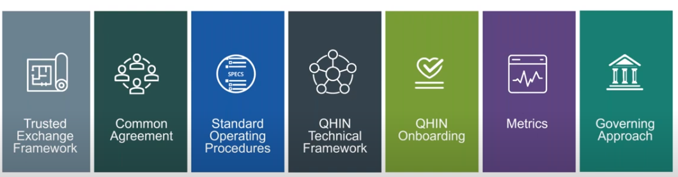
Trusted Exchange Framework and Common Agreement (TEFCA)
Need for TEFCA
How TEFCA revolutionizes interoperability
QHIN and QTF
Components and working principles

Slide 4
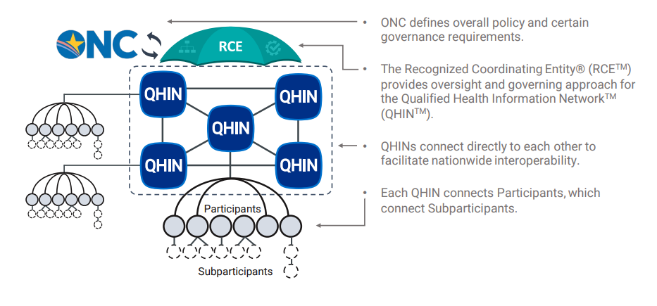
Trusted Exchange Framework and Common Agreement (TEFCA)

Slide 5
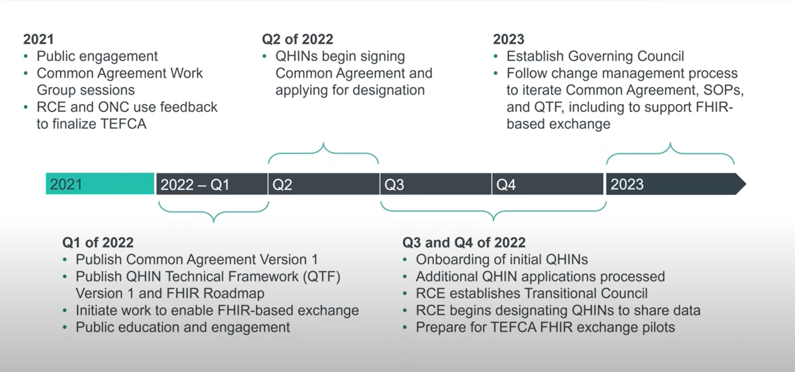
Trusted Exchange Framework and Common Agreement (TEFCA)

Slide 6

Fast Healthcare Interoperability Resource (FHIR)
A robust data model for describing health and administrative data
A RESTful API for interacting with that data using JSON or XML
A set of open-source tools to implement and test FHIR applications
A community of implementers working together.

Slide 7
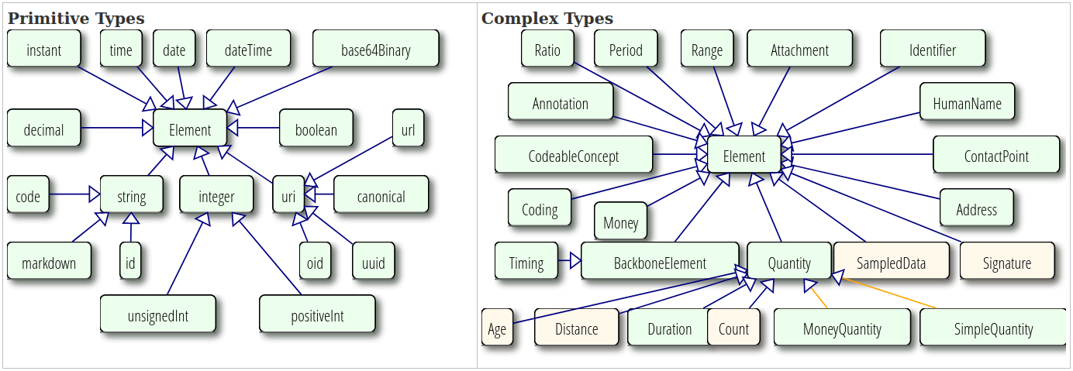
Fast Healthcare Interoperability Resource (FHIR)
Data model
Data types
Resources
Extensions
Serialization

Slide 8
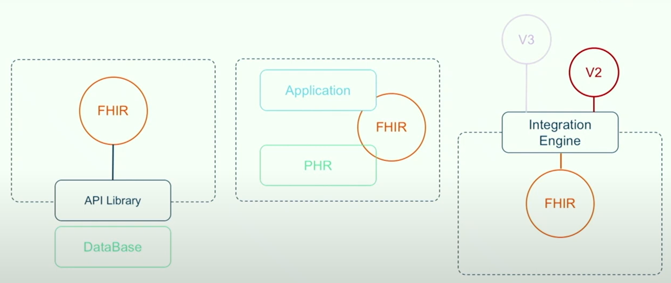
Fast Healthcare Interoperability Resource (FHIR)
Exchange framework
Rest API
Searchability
Security
Subscriptions

Slide 9


Open Source FHIR - HAPI
HAPI – An open-source Java project which implements FHIR RestAPI
HAPI is a product of Smile CDR developed 18 years ago
Vast community and sophisticated documentation
Flexible modules and easy to implement

Slide 10
Time for Demo

Slide 11
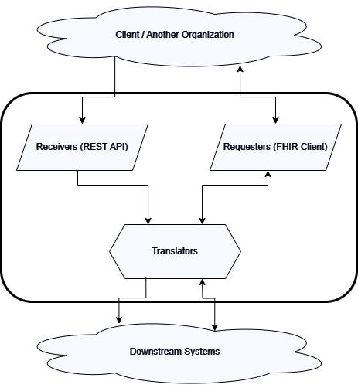
Scope for growth
Sophisticated Architecture
Distributed Systems
Data handling and translators
Proper error handling and analysis
Take it to the clouds

Slide 12
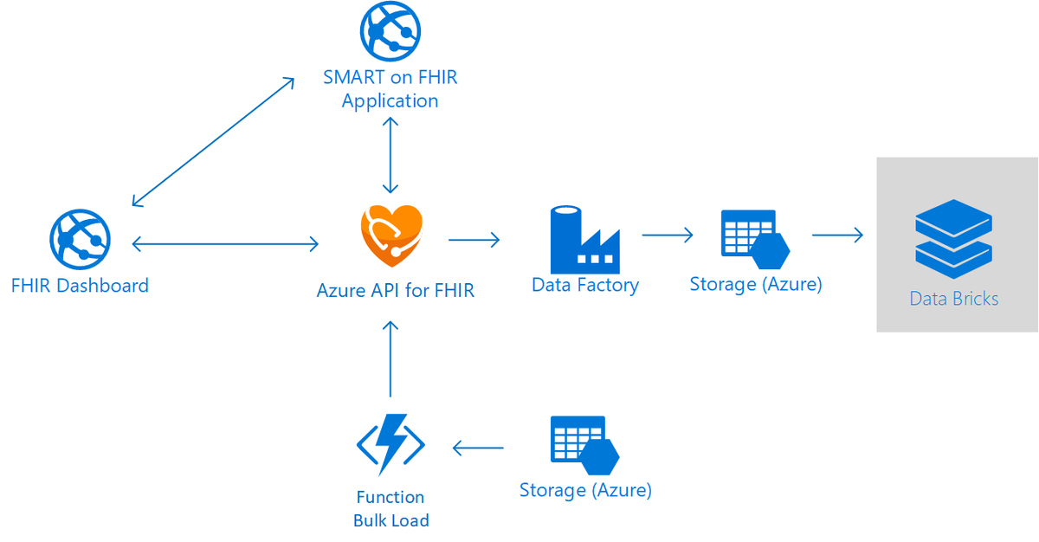
Cloud APIs - Azure
https://learn.microsoft.com/en-us/azure/healthcare-apis/azure-api-for-fhir/overview

Slide 13
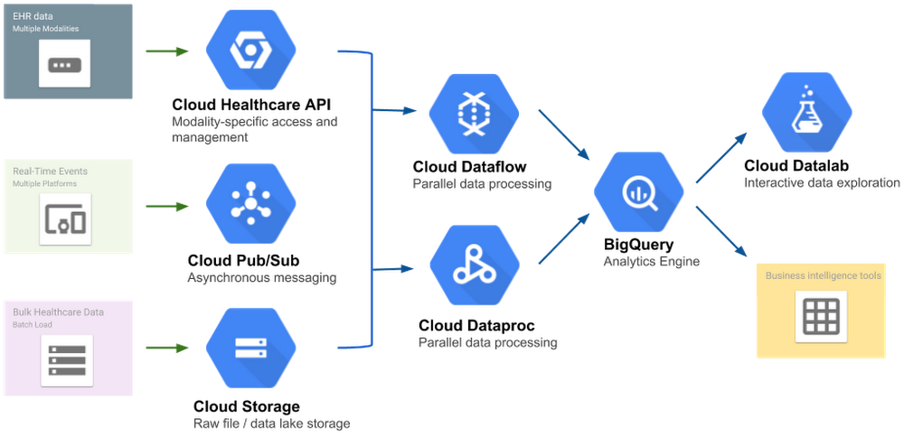
Cloud APIs - Google
https://cloud.google.com/healthcare-api/docs/concepts/fhir

Slide 14
Thank you

